Slide 1

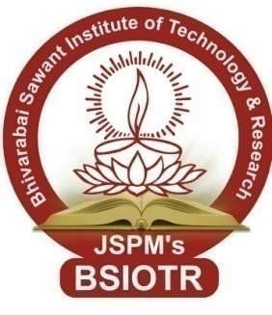
JSPM’s
Bhivarabai Sawant Institute of Technology & Research
Accredited with ‘B++’ Grade by NAAC
Department of Information Technology
Project Review - 3
“A Novel Approach For Blood Bank And Donor Management system”
Presented By :
Mr. Aniket Khalate (72033470F)
Mr. Ajay Sonawale (72033577K)
Mr. Akshay Bankar (71918445C)
Mr. Suraj Tupkar (72033593M)
Guided By : Prof. Bhagyshree Kadam

Slide 2
Content
Introduction
Motivation
Problem Statement
Literature Survey
Existing System Vs Proposed System
System Architecture/Block Diagram
Requirements(Software/Hardware)
Methodologies
Advantages
Applications
DFD Diagram
UML Diagram
Sample Results
Conclusion
Future Scope
References

Slide 3
Introduction
Blood is a vital component of the human body and plays a critical role in maintaining the normal functioning of organs and tissues. However, due to various medical conditions such as accidents, surgeries, and diseases, blood transfusion is constantly demanded in hospitals and healthcare centres. Blood banks serve as a critical link between donors and recipients by collecting, testing, processing, and distributing blood and its components. Donor management systems have been developed to automate and streamline the process of blood donation, reduce the risk of errors, and improve the efficiency of blood bank operations.

Slide 4
Motivation
The main purpose of this system is to keep an organize records management of blood.
Information such as Donor Details , Blood Collection , Screening , Component preparation , Blood storage , Blood request , Compatibility, Blood issue , Monthly statistics records are stored using database .

Slide 5
Problem Statement
Scarity of rare blood group.
Unavailability of blood during an emergency.
Less awareness among people about blood donation and blood transfusion.
Deaths due to lack of blood during the operation.

Slide 6
Literature Survey
SR. N0. | PROJECT TITLE | YEAR | AUTHOR | CONCLUSION
1 | E-Blood Bank Android. Application for Donors and Life Savers. | 2021 | Karima Ghazali | We should not be surprised now at the huge number of researchers who work in the field of technology and care about health, as it is the mainstay of human life.
2 | Blood collection supply chain management | 2020 | Bellabdaoui Adil | We have tried to identify different perspectives in terms of which to classify the existing manuscripts
3 | Improving Blood Bank Inventory Management Using Double Cross-match. | 2020 | Mehdi Najafi | This waiting during the CRP increases the chance of blood reaching the maximum shelf life.
4 | Smart Blood Bank App | 2019 | Surabhi S. Pohandulkar | Blood is the vital part of the body. It can not be produced artificially in any laboratory.

Slide 7
Existing System
Many existing blood bank and donor management systems are manual, paper-based, or outdated. These systems are inefficient, prone to errors, and time-consuming. Additionally, there is poor coordination between stakeholders, resulting in inadequate blood supply and poor management. Furthermore, donor participation is low, with many donors not willing to donate blood due to fear, misinformation, or lack of incentives. These challenges affect the overall effectiveness of the blood bank and donor management system.

Slide 8
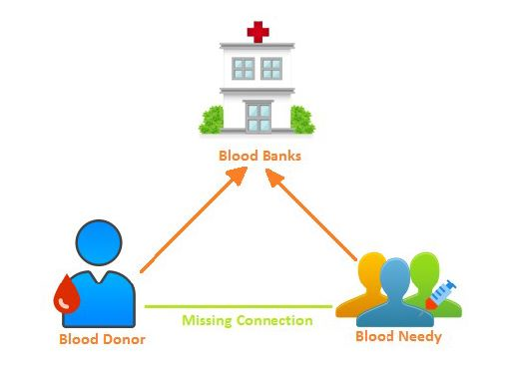
Existing System

Slide 9
PROPOSED SYSTEM
The proposed blood bank and donor management system comprise three main components: the blood inventory management system, the donor management system, and the blood product distribution system. The blood inventory management system utilizes Web Based technology to store secure and tamper-proof records of blood donations, testing results, and inventory levels. The donor management system enables efficient management of donor records, including personal information, medical history, and eligibility criteria.

Slide 10
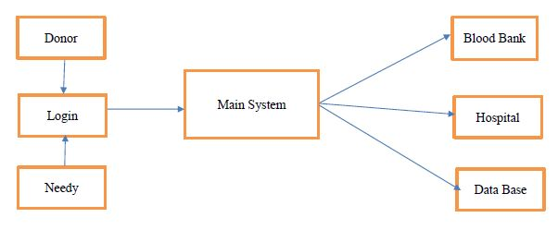
PROPOSED SYSTEM

Slide 11
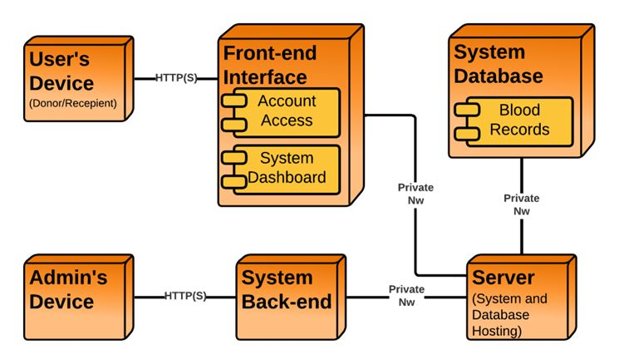
System Architecture/
Block Diagram

Slide 12
Requirements
(Hardware/Software)
Hardware Requirements :
i. Processor:2 GZ minimum ,Dual Core Processor, 64 bit
ii. RAM:8/16 GB
iii. Hard – Disk:512 GB SSD
Software Requirements :
1. Operating System: Windows Operating System
2.Visual Studio Code
3. MySQL Workbench.
Technology Requirements :
React js.
MySQL
Node.js

Slide 13
Methodologies
Agile methodology :-
This methodology emphasizes collaboration, flexibility, and rapid delivery. It involves breaking down the project into small iterations or sprints, with each sprint delivering a working piece of the system. Agile methodology is particularly useful when requirements are unclear or changing.
We breakdown our project into two main categories
Admin
User(Donor ,Needy)

Slide 14
Advantages
Improved blood inventory.
A proper database will be generated .
A unique blood bank management system with multiple benefits.
Improved patient safety through human error reduction.
Workflow efficiency and productivity.

Slide 15
Applications
Donor Registration Management.
Ability to manage the information of its blood donor.
Ensures hospitals have a good supply or inventories of blood bags.
List the availability of blood bags at any given time.
Ability to manage the information of its blood Needy.
Alerts for blood requirements from registered donors.

Slide 16
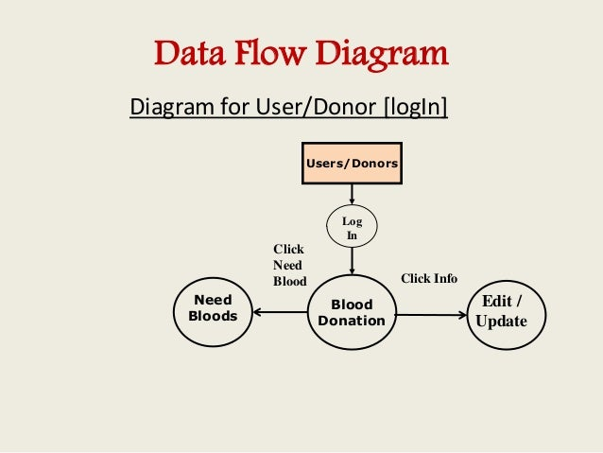
DFD Diagram For Donor Login

Slide 17
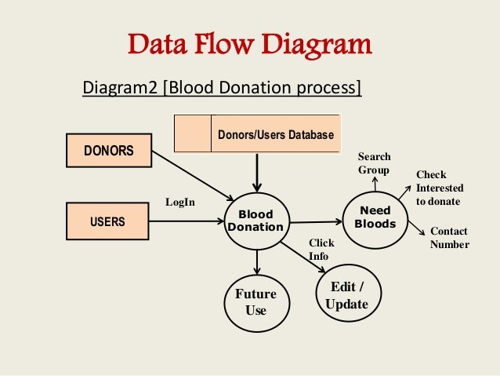
DFD Diagram For Process

Slide 18
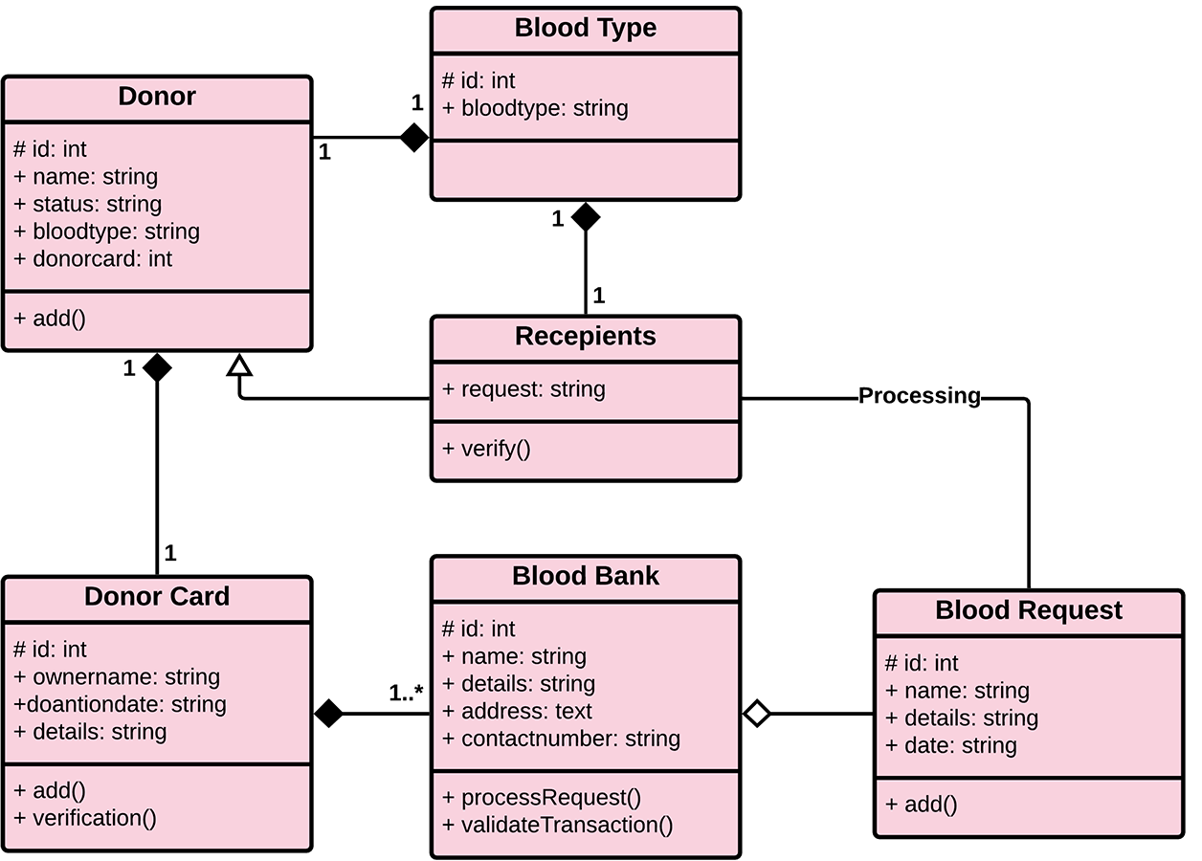
Class Diagram

Slide 19
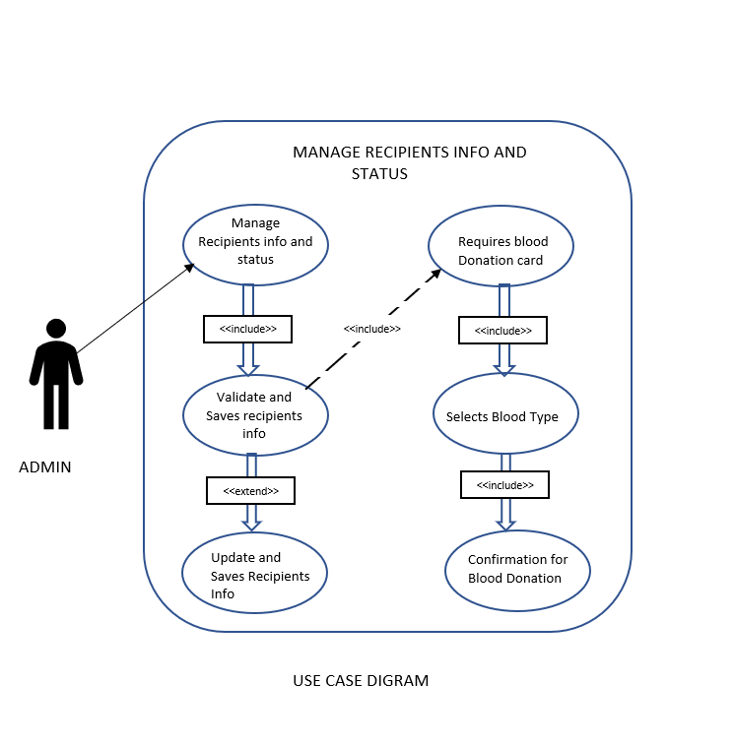
Use case Diagram

Slide 20
Conclusion
The best solution is to use the “A Blood Bank And Donor Management system” to help the needy find blood donors in a quick, perfect and safe way also with less effort.
A Blood Bank And Donor Management system is a concept to combine the donation system with donors, Blood Providers and Blood Needy preferences and their points of view.

Slide 21
Future Scope
There is always a scope for enhancements in any developed system, especially when the project is built using the latest trending technology and has a good scope in future
Web based platform can be upscaled to a browser plugin for ease of access to the user.
Currently all applications switching towards the web application technology for enhancement of the application.

Slide 22
References
Surabhi S.Pohandulkar and Chhaya S. Khandelwal “ Smart Blood Bank App ” International Journal of Applied Engineering Research ISSN 0973-4562 Volume 14,
Clemen Teena, K. Sankar and S. Kannan “A Study on Blood Bank Management” Middle-East Journal of Scientific Research 19 (8): 1123-1126
Mohammed Anis Oukebdane, Samir Ghouali, Karima Ghazali “E-Blood Bank Android Application for Donors and Life Savers.

Slide 23


